Slide 1
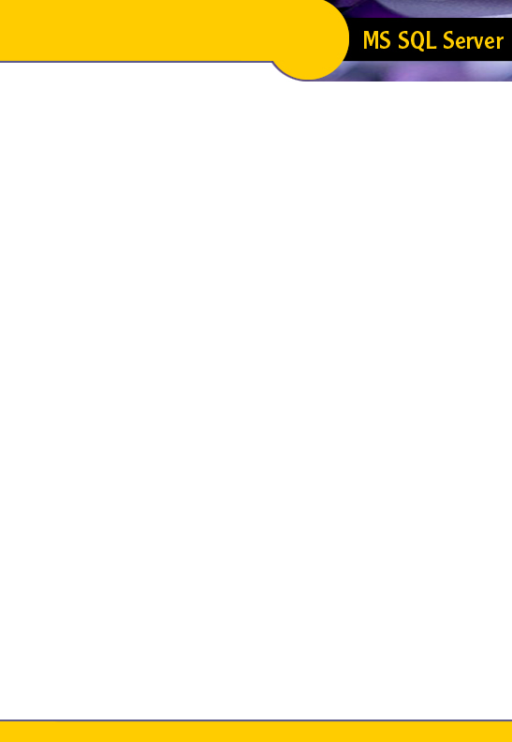

Introduction To SQL
Unit 15
Introduction To TSQL
Unit 15
Modern Business Technology
Notes:
1

Slide 2
Triggers
Triggers are a special type of stored procedure that go into effect when a user issues an insert, update, or delete on a table
Executing a trigger is called "firing the trigger"
Triggers are automatically executed when an insert, update, or delete is performed
Triggers are not directly called or executed
Notes:
2

Slide 3
Triggers
Triggers are used to:
  Enforce referential integrity
  Custom business rules
  Admin functions
Cascading updates and deletes can only be accomplished through a trigger
Notes:
3

Slide 4
Referential Integrity (RI)
RI is the process whereby relationships are maintained within the data
A child row without a parent row is referred to as an orphan
RI prevents orphans
For example:
A title can not exist without an author
If the author is deleted, his titles can not exist in the table
Notes:
4

Slide 5
Cascading
Cascading is the process whereby changes to a parent are propagated to the child
If we update the parent value, we must also update the child value in order to maintain the relationship
The same is true of deletions
Notes:
5

Slide 6
Deletes
There are three different effects for deletes:
  Delete
    When the parent is deleted, all corresponding children are also deleted
  Restrict
    If a child exists, do not allow the deletion of the parent
  Set Null
    When a parent is deleted set the corresponding child value to null
Notes:
6

Slide 7
Updates
Update triggers have only two effects:
  Update
    When the parent changes, change the child
  Restrict
    If a child exists, do not allow changes to the parent
Notes:
7

Slide 8
Roles of Triggers
Triggers can be a very powerful addition to any application
Triggers are used for the following additional functions:
  Maintain duplicate data
    Used to create an additional copy of the data for use in another system
  Maintain derived data
    Used to maintain aggregated data so that an application doesn't have to create the aggregate on the fly
  Enforce complex restrictions
    Enforce business rules such as a person can not have a salary > 1 million dollars
  Perform custom recording
    Acts as an additional audit trail
Notes:
8

Slide 9
Action of a Trigger
When data is inserted, updated, or deleted from a table the trigger fires
The trigger fires after the data is in the table
The trigger is part of the same transaction as the modification statement
A trigger is fired only once for a modification statement
  If you insert 5000 rows in a single transaction, the trigger will only fire once
The trigger can roll back the transaction or send and error back to the client (raiserror)
Notes:
9

Slide 10
Create a Trigger
create trigger trigger_name on table_name
for {insert | update | delete}
[,{insert | update | delete}]…
as
SQL statements
A table can have up to three triggers:
  1 for insert
  1 for update
  1 for delete
Only the table owner can create a trigger
Triggers can not be directly called or take parameters
Notes:
10

Slide 11
Create a Trigger
The for clause indicates for which modification statement(s) will fire the trigger
Multiple events can be defined for a single trigger
  insert and delete
  create trigger tiu_sales on sales
  for insert, update as ...
Conform to a specific naming convention for triggers:
  t[i,u,d]_tablename
  i.e. ti_sales, td_sales, tiu_stores, tud_authors, tiud_employee
Notes:
11

Slide 12
Special Tables
Triggers have access to special temporary tables
These tables do not exist and can not be accessed outside of the trigger they are created for
These tables are
  inserted
    Contains any rows added to a table as the result of an insert or delete
  deleted
    Contains any rows removed from a table as the result of an update or delete
Notes:
12

Slide 13
Special Tables
The inserted table contains rows whenever an insert or update is performed
The deleted table contains rows whenever an update of delete is performed
An update is considered an insert/delete pair
When data is updated, the image of the data before the row was changed is placed in the deleted table. The image of the row after the data is updated is contained in the inserted table
Notes:
13

Slide 14
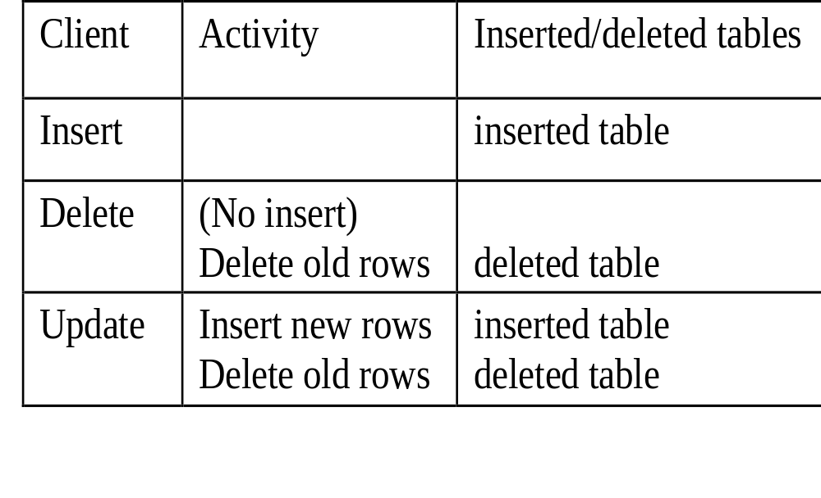
Special Tables
Inserted and deleted have the same structure as the table that is being inserted into, updated, or deleted from
Notes:
14

Slide 15
Update Triggers
A very important concept to understand is that an update is actually an insert/delete pair (in most cases)
However, you can not interact with the insert or the delete portions of an update
This is all hidden behind the scenes by SQL Server
Notes:
15

Slide 16
Update Triggers
So, if I can't interact with the insert or delete happening for an update, why should I even know about it?
You need to know because of the effect on the inserted and deleted tables
The before image is stored in the deleted table
The after image is stored inserted table
Notes:
16

Slide 17
How Triggers Work
When you insert, update, or delete rows from a table that has a trigger, it is fired
  It fires whether or not any rows are effected
  @@rowcount will tell you how many rows are effected
  If you are inserting and a kkey violation occurs, the trigger will not fire
By checking @@rowcount in your code, you can avoid unnecessary processing
If @@rowcount = 0 exit the trigger
Notes:
17

Slide 18
Row Counting
The row counts can be used to verify a dependent table correctly refers to the parent table
create trigger ti_salesdetails on salesdetails for insert as
declare @numrows int
--Get the rows effected as this changes
-- every time data is modified
select @numrows = @@rowcount
if (select count(*) from titles t, inserted i where t.title_id = i.title_id) != @numrows
begin
...
Notes:
18

Slide 19
Row Counting
An alternative method to the …select count(*)… is to use an exists query
An exists query will return a true as soon as a matching value is found
It also alleviates the multirow problem
Notes:
19

Slide 20
Delete Example
Example: Delete Trigger
create trigger td_publishers
on publishers for delete as
--if no rows deleted exit trigger
if @@rowcount = 0
  return
--For deleted publishers, delete corresponding titles
delete titles from titles t, deleted d
where t.pub_id = d.pub_id
--Any additional actions
return
Notes:
20

Slide 21
Insert Example
Example: Insert trigger
create trigger tiu_titleauthor on titleauthor for insert, update as
--Find number of rows modified
declare @numrows int
select @numrows = @@rowcount
if @numrows = 0
return
--Make sure all title ids match
if (select count(*) from titles t, inserted i where t.title_id = i.title_id) != @numrows
begin
raiserror 31113 "Attempt to insert invalid title_id into titleauthor"
rollback transaction
return
end
--Make sure all au_ids match
if (select count(*) from authors a, inserted i where a.au_id = i.au_id) != @numrows
begin
raiserror 31114 "Attempt to insert invalid au_id into titleauthor."
rollback transaction
return
end
return
Notes:
21

Slide 22
Update Trigger
You can check to see if a column has been changed by using the if update clause
if update (columnname)
[{and | or} update (columnname)]…
Returns true if the specified column has been modified
This eliminates unneeded processing
If update can only be used in a trigger
Notes:
22

Slide 23
Update Example
Example: Update trigger
create trigger tu_publishers on publishers for update as
--Find out how many rows were modified
declare @numrows int
select @numrows = @@rowcount
if @numrows = 0
return
if update (pub_id) --Was primary key updated
begin
--Multiple updated rows not allowed
if @numrows > 1
begin
raiserror 31113 "Update to primary keys of multiple rows is not permitted."
rollback transaction
return
end
--Cascade update to titles table
update titles set t.pub_id = i.pub_id
from titles t, inserted i, deleted d
where t.pub_id = d.pub_id
end
return
Notes:
23

Slide 24
Multi-row Operations
It is very important to take into account the possibility of multi-row insert, update, deletes
You can get this information from @@rowcount
If @@rowcount is > 1 then you have multiple rows in the inserted and deleted tables to be concerned with
If a set operation is not possible, cursors are used to handle the multiple rows
Notes:
24

Slide 25
Triggers
To get the text of a trigger or stored procedure, use sp_helptext
sp_helptext [proc_name | trigger]
To see object dependencies, use sp_depends
sp_depends tablename will show all of the triggers that reference a given table
sp_depends triggername will show all of the tables that are referenced by a trigger
To drop a trigger, use the drop command
Notes:
25

Slide 26
Comparison
There are two methods of maintaining referential integrity
  Triggers
  Declarative RI
The main difference between the two is that triggers can accomplish cascading updates and deletes. DRI is not capable of this
Notes:
26

Slide 27
Transaction Control
You can not rollback to a named transaction in a begin tran inside of a trigger
A run time error will occur
Everything is rolled back and the trigger and proc are aborted
Notes:
29

Slide 28
Transaction Control
If you have a nested trigger, the rollback trigger will roll back all work done in all of the triggers and also the DML that fired the first trigger in the chain
Issuing a rollback trigger outside of a trigger will cause SQL Server to ignore it
A rollback trigger outside of a trigger, but inside of a transaction will cause SQL Server to rollback and abort the batch
Notes:
32

Slide 29
Nested Triggers
Triggers can be nested up to 16 levels deep
The 16 level limit is a combination of triggers and regular stored procs
After 16, the entire transaction is aborted
You can disallow nested riggers with a configuration option
Notes:
35

Slide 30
Nested Triggers
A trigger will normally not call itself
  An update is issued which fires and update trigger on the table. The update trigger updates the same table. The second update will not fire the trigger again
  By using set self_recursion (Sybase) or changing the nested triggers option(MS SQL Server), you can recursively call a trigger up to 16 times
Notes:
36

Slide 31
Restrictions
Parameters can not be passed to a trigger
insert, update, and delete statements inside of a trigger do no affect the inserted and deleted tables for the trigger
Views and temporary tables can not have triggers
You can not create objects in a trigger
Do not rollback to a named transaction in begin tran
Notes:
37

Slide 32
Notes
You can nest or recurse triggers up to 16 levels deep with the proper settings
Triggers can execute stored procs
When you define a new trigger for an action, the old trigger is overwritten
Minimally logged operations such as truncate table and bcp do not fire triggers
To return info to a user from a trigger use print or raiserror
Notes:
38

Slide 33
Unit 15 Review
A trigger is a special type of stored procedure that is executed automatically when a DML statement is issued
Triggers are used to enforce RI, apply custom business rules, and perform admin functions
Every table can have up to three triggers
Each trigger has access to it's own special temporary tables called inserted and deleted
An update causes an insert/delete pair to be performed
If update allows you to test if a particular column has been changed
For any type of cascading operations, you must use a trigger to enforce RI instead of DRI
Triggers can be nested up to 16 levels deeo
Triggers can also recursively call themselves up to 16 levels deep
Notes:
39

Slide 34
Unit 15 Exercises
Time allotted for exercises is 1/2 hour
Notes:
40

